Slide 1
Case Study – Text Mining Online Job Postings

Slide 2
Agenda
Business context and objective
Solution Approach
Data understanding and audit
Exploratory Analysis
Data pre-processing
IT Job Classification
Desired characteristics and skill sets
Desired characteristics and skill sets – over the years
Analyzing Nature of Jobs
Analyzing Nature of Jobs over time
Analysing Company Profiles
Similarity of Jobs
Conclusion

Slide 3
Business Context and Objective
Business Context:
This project seeks to understand the overall demand for labor in the Armenian online job market from the 19,000 job postings from 2004 to 2015 posted on CareerCenter, an Armenian human resource portal. Through text mining on this data, we should be able to understand the nature of the ever-changing job market, as well as the overall demand for labor in the Armenia economy.
Business Objectives:
Our main business objectives is to understand the dynamics of the labor market of Armenia using the online job portal post as a proxy.
Business questions answering to our business objectives are defined as follows:
Job Nature and Company Profiles: What are the types of jobs that are in demand in Armenia? How are the job natures changing over time?
Desired Characteristics and Skill-Sets: What are the desired characteristics and skill-set of the candidates based on the job description dataset? How these are desired characteristics changing over time?
IT Job Classification: Build a classifier that can tell us from the job description and company description whether a job is IT or not, so that this column can be automatically populated for new job postings. After doing so, understand what important factors are which drives this classification.
Similarity of Jobs: Given a job title, find the 5 top jobs that are of a similar nature, based on the job post.

Slide 4
Solution Approach
We would pre-process the data for punctuations, numbers etc.
Toeknaization, StopWord removal, Lemmatization would be performed suitably.
For the IT Job classification business question, we would aim to create supervised learning classification models that are able to classify based on the job text data accurately, is it an IT job.
On the business question of Job Nature and Company Profiles, we would use unsupervised learning techniques, such as topic modelling on time period segmented dataset. Qualitative assessment will be done on the results to help us understand the job postings.
To understand the desired characteristics and skill-sets demanded by employers in the job ads, unsupervised learning methods such as K-means clustering will be used after appropriate dimension reduction.
To return the top 5 most similar job posting, we would use TFIDF similarity scores that are obtained using cosine similarity scores, ranked and returned as the answer which is then evaluated individually for relevance.

Slide 5
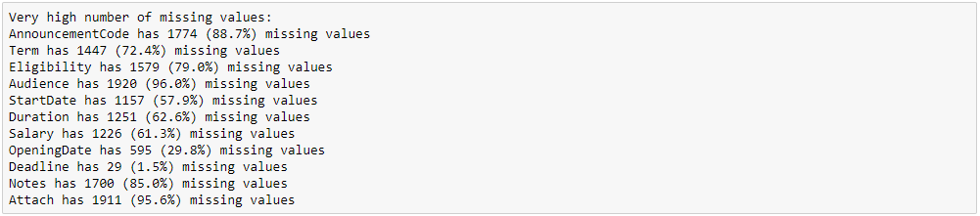
Data understanding and Audit
Data provided to us was a dump of job posts from an online Armenian job portal/
There were 19001 online job posts.
Data consisted of 24 variables – 2 numerical, 1 Boolean and 22 categorical variables.
All 22 categorical variables contained unstructured text data.
‘jobpost’ variable is the most important for our analysis and it is an amalgamation of the following columns:
Title, Company, Location, JobDescription, JobRequirment, RequiredQual, ApplicationP, Deadline, AboutC
There are a lot of missing values in some of the columns, examples below. We would ignore them of our
analysis.

Slide 6
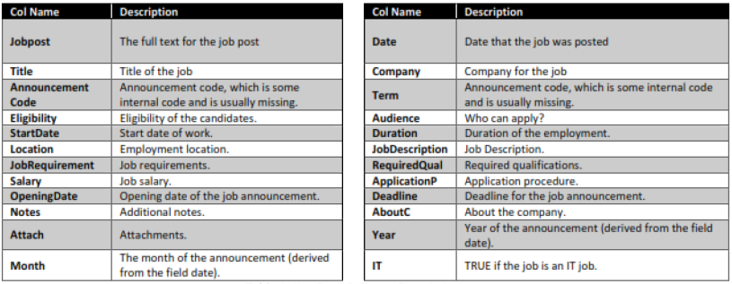
Data understanding and Audit
Key Data Columns Description below:
We looked at the variables if we could renaming columns appropriately but no name change is required
78 duplicate rows were found in the data, these were removed.
We checked if any type conversion is required for analysis, it is not required.

Slide 7
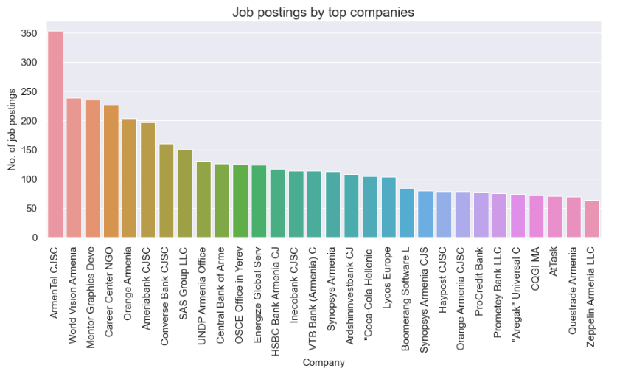
Exploratory Analysis
Below is the distribution on job postings by companies between 2004 and 2015. Quick check on the web reveals the nature of these companies, most of the job posts are from retail, banking and technology domains.

Slide 8
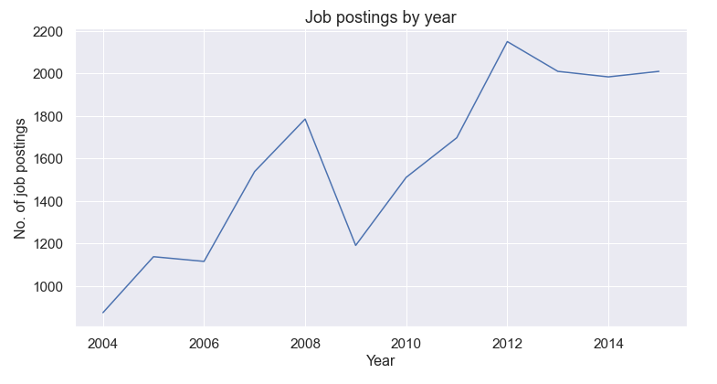
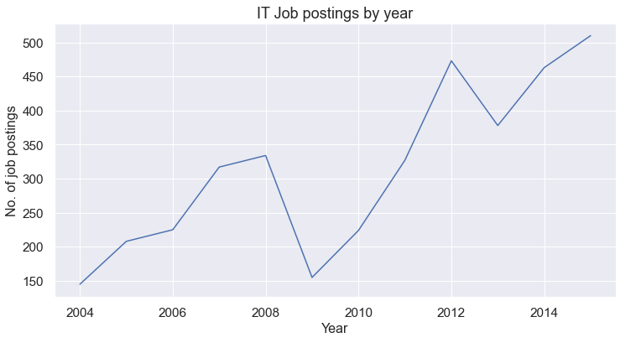
Exploratory Analysis
Both overall job postings per year and IT job postings per year show a similar upward trends. Though from 2013 onwards, overall postings have flattened out while IT postings have continued the upward trend.
There is dip observed from 2008 to 2009 and 2012 to 2013 for both overall postings and IT postings.

Slide 9
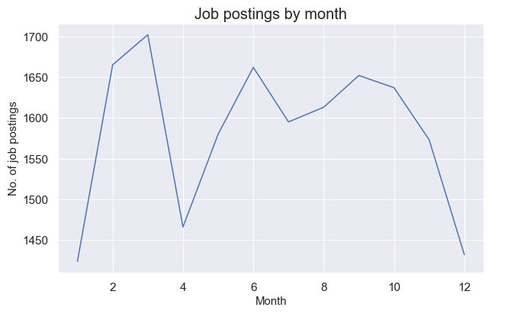
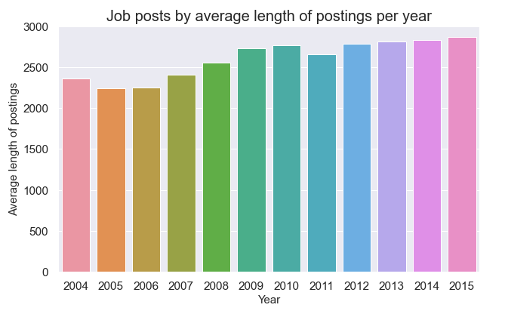
Exploratory Analysis
Looking at the monthly job posting data, there is a substantial dip October – January due to the holiday season and the posting pick up there after and is at its peak in March.
Majority of job postings are under 2500 characters.

Slide 10
Data pre-processing
For the purpose of our analysis, we needed to look at jopost, JobDescription, JobRequirment, RequiredQual, ApplicationP, AboutC columns. The following text preprocessing items were run on the columns as and when needed.
Removal of any web address
Regex: '(www\.[^\s]+)|(https?://[^\s]+)'
Removal of any email address
Regex: '\S*@\S*\s?
Removal of any numbers, within or standalone. This took care of any phone numbers as well.
Regex: '\d+'
Removal of new line characters.
Regex: '\s+'
Removal of special characters.
Regex: "[-()\"#/@;&:{}`+=~|.!?,'0-9]"
Removal of continuous spaces with 1 space character
Regex: ' +'
Move all characters to lower case.
For the jobpost column: Total word count in the corpus: 7142593
For the jobpost column: Total unique word count in the corpus: 4519313

Slide 11
Data pre-processing
We removed the following text from jobpost column as it was redundant:
"To place a free posting for job or other career related opportunities in your organization at careercenter.am website, e-mail us at mailbox"
Stop words were removed using gensim.parsing.preprocessing.STOPWORDS
We added the following words to the stopword list, these were mainly section headers in the unstructured text.
'title','duration','location','description','responsibilities','required','qualifications’, 'armenia', 'armenian’,
'remuneration','application','procedures','deadline','about','company', 'start','date','job','position'
Tokenization was done using NLTK’s word_tokenize function.
Part-Of-Speech (POS) tagging: we assigned a tag to every word to define if it corresponds to a noun, verb, adverb and adjective using the WordNet lexical database.
Lemmatization was done using NLTK’s WordNet lemmatizer to reduce the similar meaning words to their root form (e.g. rooms -> room, slept -> sleep)
After Lemmatization if a word was a two letter word, then was removed.
Ex. Went → go , go was removed
Spacy library was used to perform Named Entity Recognition to filter out the Person Names like ‘Kirk’, ‘James’ etc.. Entity name ‘PERSON’ was used to identify names within the corpus.
After pre-processing, lemmatization, stop word removal:
Total term count in the jobpost corpus: 4178

Slide 12
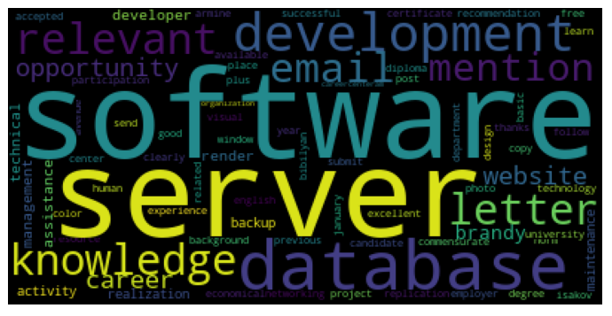
Data pre-processing
We carried out all our data pre-processing steps on jopost column and as a test of relevance, we created a word could on a software developer job post (row 5 in the data). We see that the below word could is in line with the requirements of a software developer with server side and database skills.

Slide 13
IT Job Classification
Model Building and execution
In order to classify whether a job post is an IT job or not, we used the jobpost and IT columns from the our text corpus.
jobpost became our X variable and IT was our target variable.
2 ML algorithms – Naïve Bayes and Extreme Gradient Boost were tried and we compared the Accuracy and ROC-AUC scores.
Both the above ML techniques were tried with CountVectorizer DTM and TfidfVectorizer TF-IDF.
Data was pre-processed including removal of stop words, tokenization, lemmatization as has been described in the earlier slides.
Data was split into train and test. Model was built on train and validating on test before actual prediction.
Test to Train split was 30% and 70% . The models were trained on train data before predicting on the test data.
Final tuning parameters for Naïve Bayes Multinomial classifier:
alpha=1.0, class_prior=None, fit_prior=True
Final tuning parameters for XGBClassifier:
gamma=1, learning_rate=0.01, max_depth=5, min_child_weight=1,
n_estimators=1000, n_jobs=-1, random_state=42, verbose=1

Slide 14
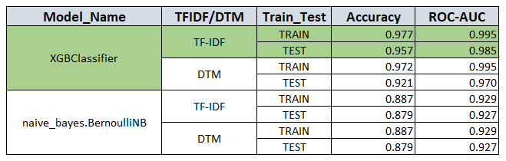
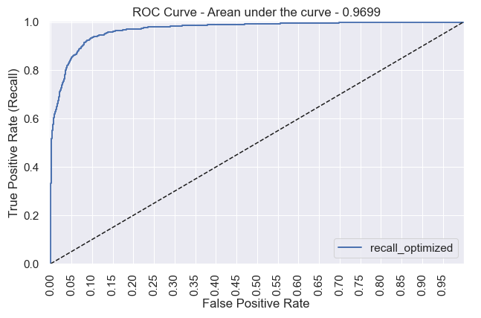
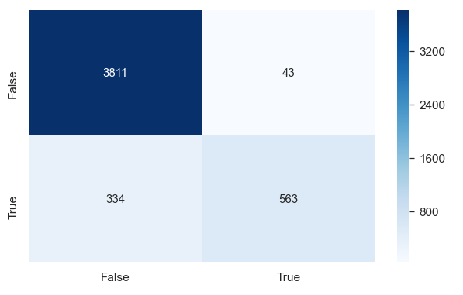
IT Job Classification
Model Comparison
Finalized Model:
We chose XGBClassifier with TF-IDF over the other models.
Accuracy and ROC scores were better on test data for XGBClassifier with TF-IDF than the other models.
Below are confusion matrix and roc plot for XGBClassifier on test data.

Slide 15
Desired characteristics and skill sets
To understand the desired characteristics and skill set, we choose JobRequirement column for analysis as it encapsulated the characteristics required and skill compared to RequiredQual.
We used the unsupervised learning technique of K-Means segmentation which tries to classify documents into topics based on euclidian distance by initializing centroids by first shuffling the dataset and then randomly selecting K data points for the centroids without replacement.
Scikit Learn’s MiniBatchKMeans class was used instead of KMeans to built the segmentation models with a batch size of 2048. MiniBatchKMeans works similarly to KMeans , with one significance difference: the batch_size parameter. batch_size controls the number of randomly selected observations in each batch. This is useful for systems with limited resources.
Data was pre-processed including removal of stop words, tokenization, lemmatization as has been described in the earlier slides.
TF_IDF matrix was generated for whole of JobRequirement column, ignoring NaNs with the terms that remained after the processing of the data. max_features for the TF-IDF was chosen to be 2200.
We built 4, 5, 6, 7 and 8 cluster models and qualitatively analysed the results. We tried identifying similarities within the cluster but dissimilarity between the clusters.
Based on clear distinctions within the clusters, interpretability and distribution within the clusters, we chose the K=6 as the final solution although the Silhouette score was quite low compared to other cluster solution.

Slide 16
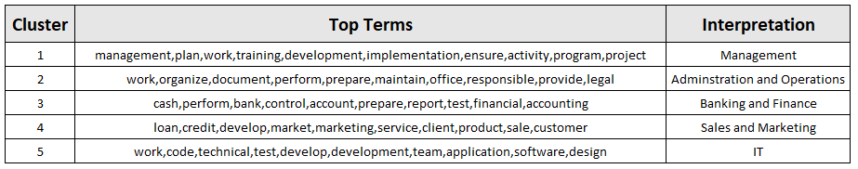
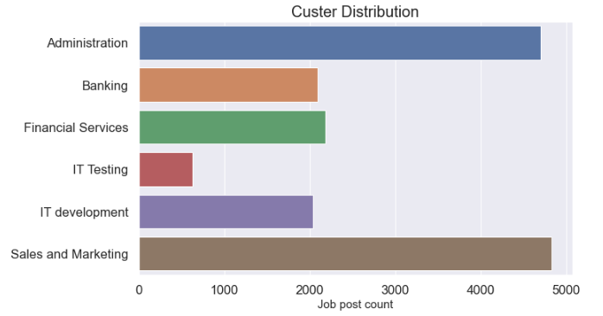
Desired characteristics and skill sets
Below are the top terms from the clusters based on centroids and their interpretations.
We see Cluster distribution plot that skills and characteristics in the administration, sales and marketing have been in demand over the years as a consolidated view over the entire time period of the job postings.

Slide 17
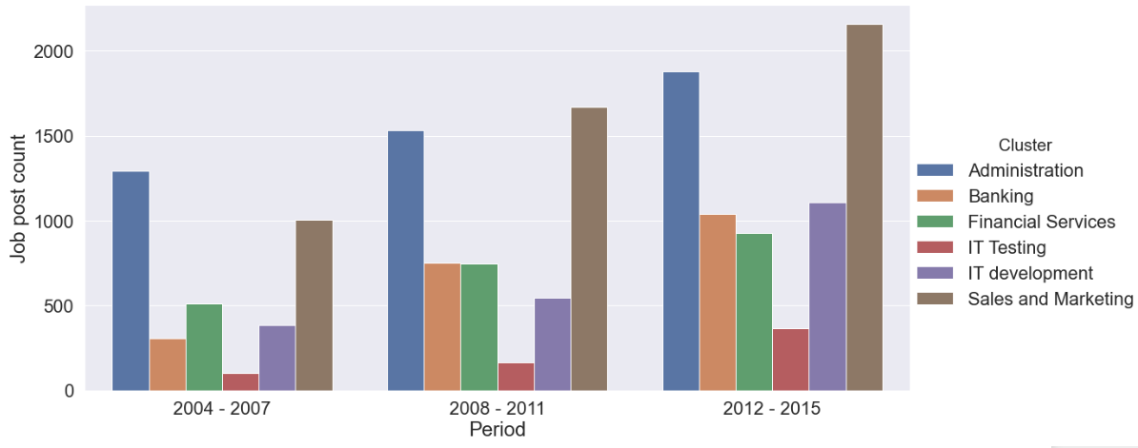
Desired characteristics and skill sets – over the years
To understand how job requirements and characteristics have changed over the years, we filtered out data from 2004 to 2015 in 3 periods of 4 years each against number of job posts, categorizing them in the defined clusters.
As we can see below, all skills have seen an upward trend over the 3 time periods. Jobs in sales and marketing overtook administrative jobs after 2007. IT development saw a significant jump from 2008-2011 to 2012-2015.

Slide 18
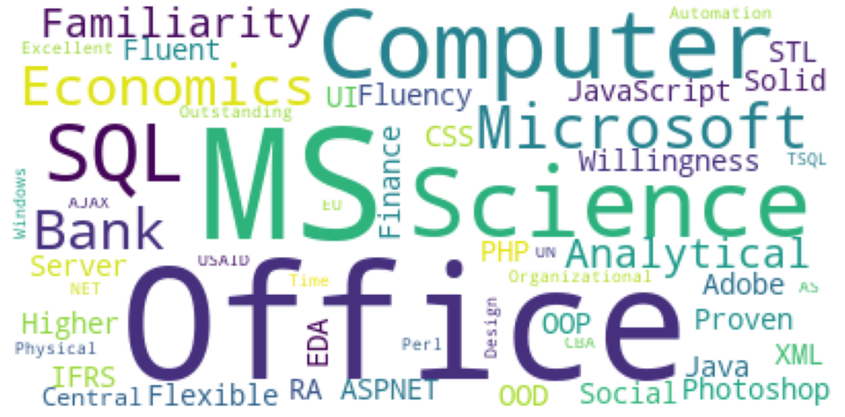
Desired characteristics and skill sets
To understand skill sets in high demand, we used the Spacy library for Named Entity Recognition on the RequiredQual column in the dataset. We focused on ‘ORG’ entity type as it contained the names of tools, software, skills etc. in the corpus over the entire period of job postings.
The results are visualized below. MS tools, computer related skills are most sought after.

Slide 19
Analysing Nature of Jobs
We analysed the nature of jobs by using the Gensim’s LdaModel class to execute the unsupervised learning technique of Latent Dirichlet Allocation(LDA) on the jobpost data column.
With Topic modelling we aim to automatically discover the hidden thematic structure in our corpus of text documents i.e.. Job posting text, in our case, by classifying terms into topics, this is also called soft clustering.
The Gensim’s LDA technique give us a list of topics, each represented as a list of terms along with the weights for the terms as well.
Data was pre-processed including removal of stop words, tokenization, lemmatization as has been described in the earlier slides.
We found that by expanding the list of stop words, example below, we can obtain better results.
'follow', 'work', 'skill', 'post', 'ability','clearly','thanks','free','provide','letter','ensure','good','time', 'place’,
'center', 'activity', 'career', 'course', 'learn', 'activity', 'candidate', 'include’ etc.
We built 5, 6, 7 and 8 topic LDA models and qualitatively analysed the results.
We chose the 5 topic model as it gave the best interpretability and looking at pyLDAvis outputs, the 5 topics gave a fairly good and even sized blobs with least overlap.

Slide 20
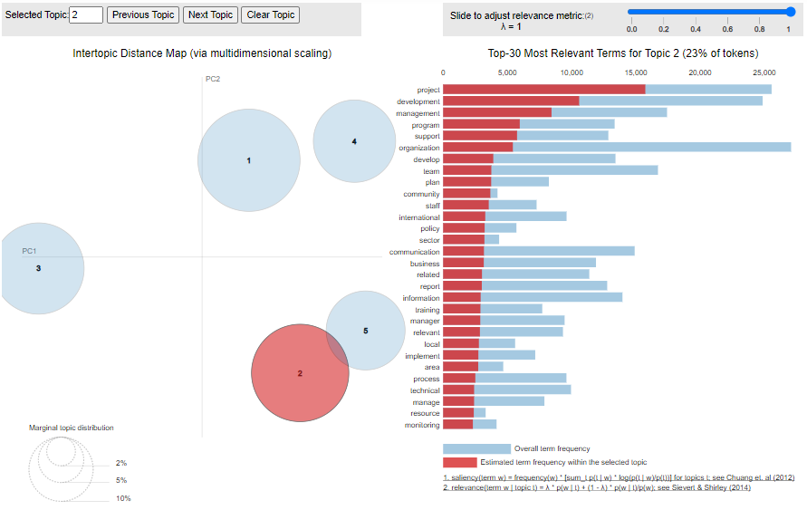
Analysing Nature of Jobs
pyLDA visualization for 5 topics model gave a fairly good and even sized blobs with least (topics 2 and 5 have a slight ) overlap – which is good. Topic numbers in pyLDAvis start from topic no. from LDA model + 1.

Slide 21
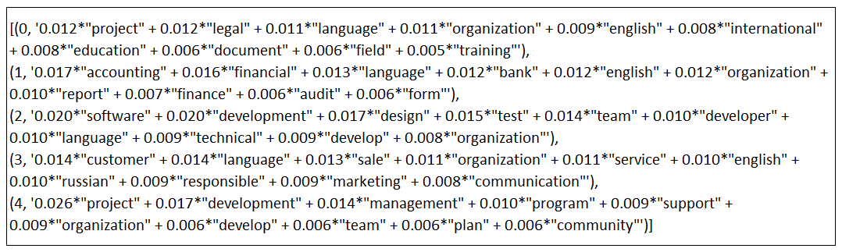
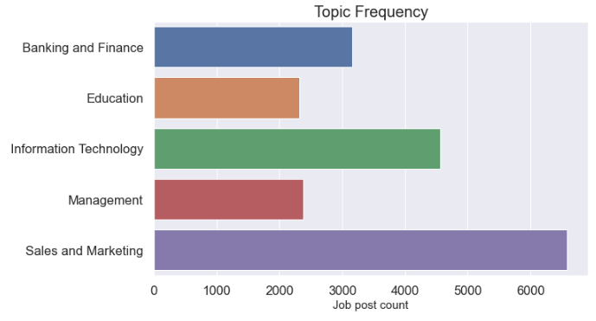
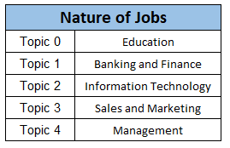
Analysing Nature of Jobs
Following are the topic modelling results:

Slide 22
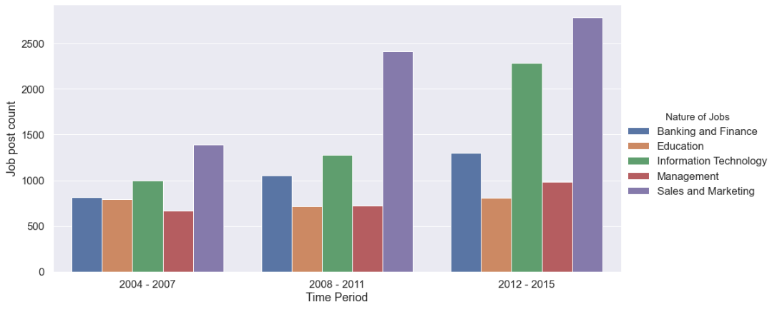
Analysing Nature of Jobs over time
To understand how the nature of jobs have changed over the years, we filtered out data from 2004 to 2015 in 3 periods of 4 years each against number of job posts, categorizing them in the defined topics (nature of jobs).
As we can see below, all have seen an upward trend over the 3 time periods. Major jump can be seen in sales and marketing requirements between 2004-2007 to 2008-2011. IT saw significant jump from 2008-2011 to 2012-2015.

Slide 23
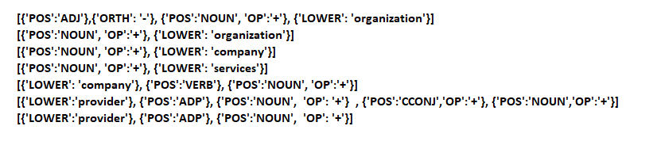
Analysing Company Profiles
We analysed the company profiles by using Spacy library’s pattern matching functionality.
The AboutC column of our data was analysed to discover simple patterns when companies are named or the nature or type of services the company provides. Following is the list of matcher rules that we used :
After the initial pass, the output from pattern matching on the AboutC column, we removed the below terms as they were not making sense and were not adding any value to our analysis.
development company', 'development organization', 'management software company’, 'project management software
company','profit organization','parent company','groups parent company’, 'development services','company visiting
www.attask.com','company delivering bespoke','company delivering bespoke business’
We were able to capture the company profiles using the above approach and visualized as a bar plot in the next slide.

Slide 24
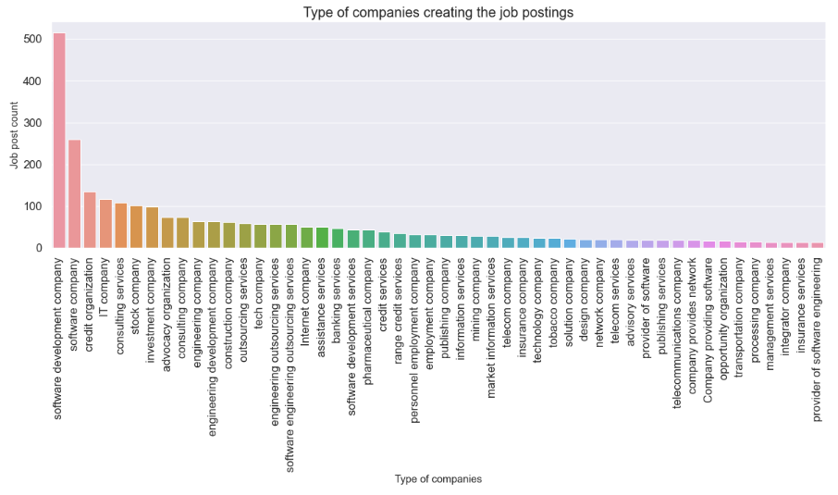
Analysing Company Profiles
Majority of the job posts are from software, consulting and financial companies.

Slide 25
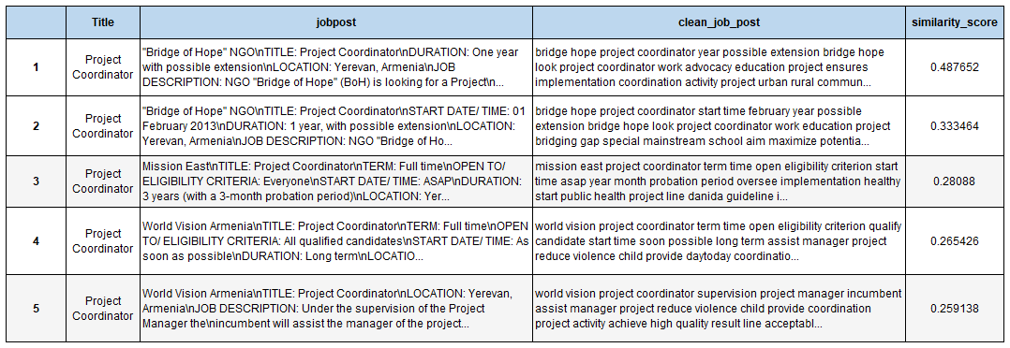
Similarity of Jobs
To analyse the similarity between job postings, we would utilize the jobpost column as it is and amalgamation of JobDescription, JobRequirment, RequiredQual and represents the job post as a holistically.
Data was pre-processed including removal of stop words, tokenization, lemmatization as has been described in the earlier slides.
We used the TF-IDF cosine similarity technique to assign similarity scores to the job posts in order to find the top 5 similar documents. Higher the similarity score more similar the documents are.
For the purpose of this exercise, we selected a random document from the corpus based on job title and found documents similar to it. This approach would imply that if a jobpost and title is provide from outside of the corpus, we would be able to find top 5 existing similar posts from the corpus.

Slide 26
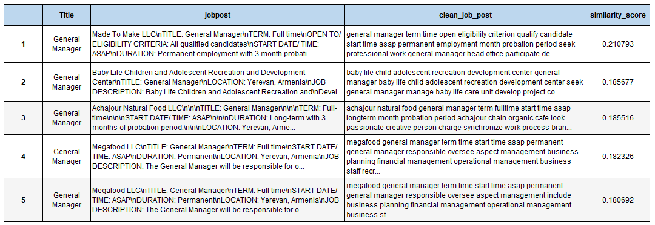
Similarity of Jobs
Sample result, top 5 similar posts for ‘General Manager’, below using TF-IDF cosine similarity technique.
Scores are not that high owing to the presence of common words and job roles.

Slide 27
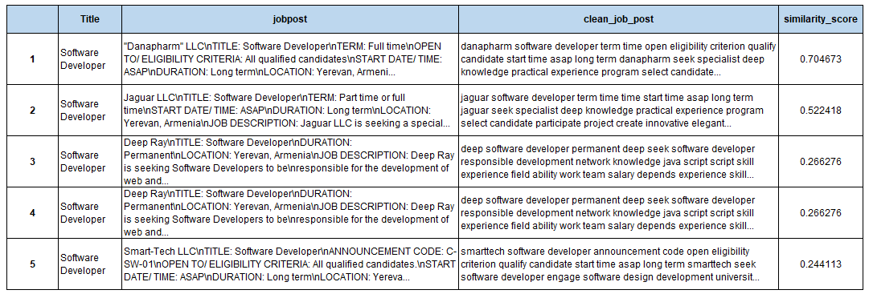
Similarity of Jobs
Another sample result, top 5 similar posts for ‘Software Developer’, below using TF-IDF cosine similarity technique.

Slide 28
Conclusion
This text mining project shows that by pre-processing and analyzing the unstructured job post data we can get valuable insights into the Armenian job market.
We were able to successfully build a classification model, which can help in tagging whether a particular job post is IT related or not.
With TF-IDF cosine similarity solution, job portal can be enhanced for the users to identifying, group and look for similar job posting.
K-Means clustering was used to better understand the Armenian job requirements, characteristics and skills for the 10 year period. Though , IT jobs saw the maximum growth but administration, sales and marketing jobs have been in high demand throughout.
With Spacy’s pattern matching solution, we gained valuable insight into the type of companies or domains that are posting or creating the maximum job. software, consulting and financial companies have been the front runners.
We applied LDA topic modelling to understand the nature of the job posts or dominant topics in the data. We ran the model over the entire period and found that sales and marketing jobs have been in major demand, followed by information technology.

Slide 29
Thank You !

